Slide 1
Energy Pairs Trading Strategy
Albert, Daniel, Gabe, Ronak

Slide 2
Energy derivatives are core to the modern financial system. They serve purposes in speculation, industrial production planning, and hedging
Notes:
Valuable to industrial companies and financial traders
Smooth out production processes for companies: allowing them to secure prices ahead of time for commodities required in their production lines
Neutralize unexpected changes in production costs
Bet on price changes in energy commodities
Traders can hedge risk exposure: if you own a lot of stock in oil companies, hedge against the price of oil by purchasing a derivative whose value moves opposite a decrease in oil.

Slide 3
Strategy
Let’s start with the origin of this project
1

Slide 4
Intuition
Volatility
Non-availability of Substitutes
Integral to economy and quality of life
Intersection with politics and macroeconomic news
Opportunity
Reasoning: securities share common determinants
Pairs Trading takes advantage of corrections to market noise

Slide 5
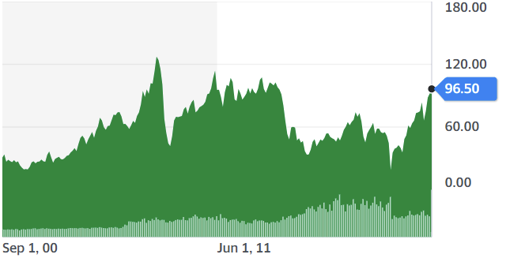
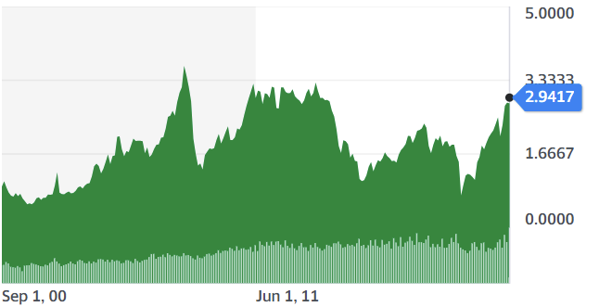
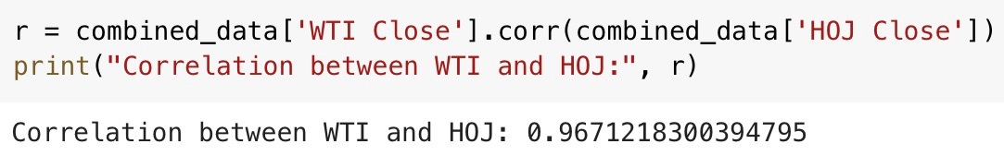
Correlation
Crude Oil (WTI)
Heating Oil (HOJ)
Notes:
Visually can see high movement correlation - can also calculate it - Correlation of WTI HOJ2: R = 0.967
Therefore these commodities are a fit for a mean-reversion strategy

Slide 6
Products:
Crude Oil - liquid hydrocarbons refined into fuel
Heating Oil - derived via fractional distillation
Notes:
- “Crude oil contains hundreds of different types of hydrocarbons that need to be separated in order to create anything useful. This is where oil refining comes into play.”
-“Distillation works because each of the hydrocarbons in crude oil have different boiling points”
- obviously more complicated but this provides some sort of sense of the commodities are different and should imply why they are correlated…

Slide 7
Code
Implementing our Ideas
2

Slide 8
Bollinger Band Parameters
Lookback Window
Tested windows varying between 10 and 130 days, incrementing by 10
Spread Width
Tested standard deviation values between 0.5 and 5.5, incrementing by 0.5
Stop-Loss Thresholds
Tested stop-loss thresholds between 0.90 and 1, incrementing by 0.01

Slide 9
Chandelier Exit
Volatility-based exit mechanism
Allows us to set trailing stop-losses
Also included hard stop-losses on initial positions
Only trade again once inside BBs

Slide 10
Pseudocode
Check stop-loss status of previous trade
Reset stop loss if in bands
If long/short:
Check chandelier trailing exit/stop loss
Hard stop loss
Elif no position:
Check to enter position

Slide 11
Performance
Executing our Strategy
3

Slide 12
Optimization - Training Data
Max Sharpe ratio = 1.74
Parameters:
Lookback window:
100 days
Spread Width:
5 standard deviations
Hard stop loss threshold:
95%
Chandelier exit:
Lookback of 22 days, multiplier of 3, 14 ATR periods

Slide 13
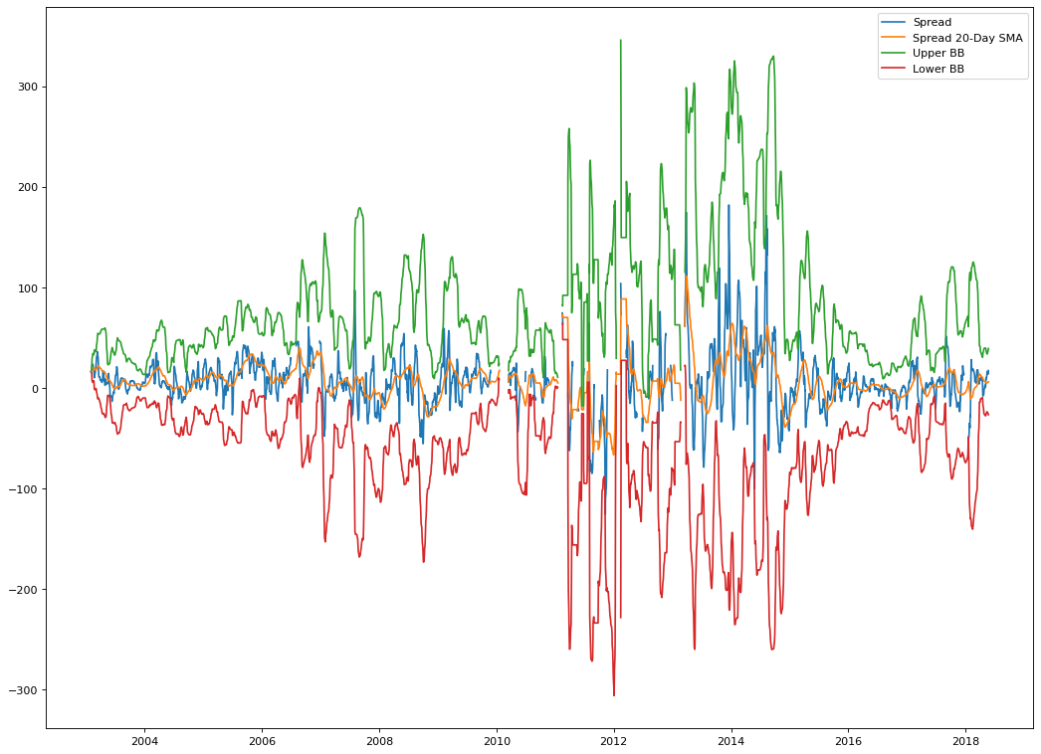
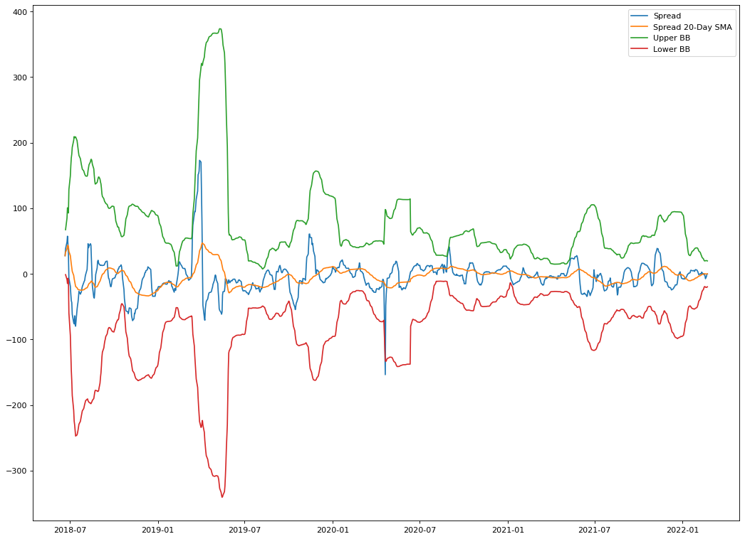
Trend over Time

Slide 14
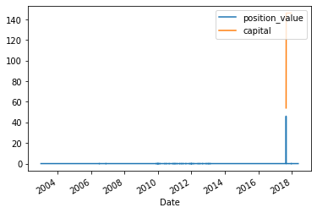
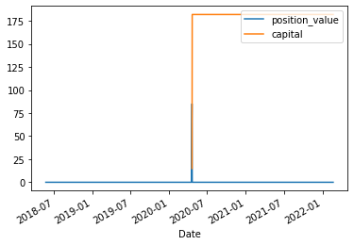
Execution

Slide 15
Test Data Results
Sharpe of 0.68
Training Data: 1.74
Very few trades
Strict Conditions
Very close correlation
Atypical of Mean-Reversion

Slide 16
Analysis
Possible Sources of Error and Future Improvements
4

Slide 17
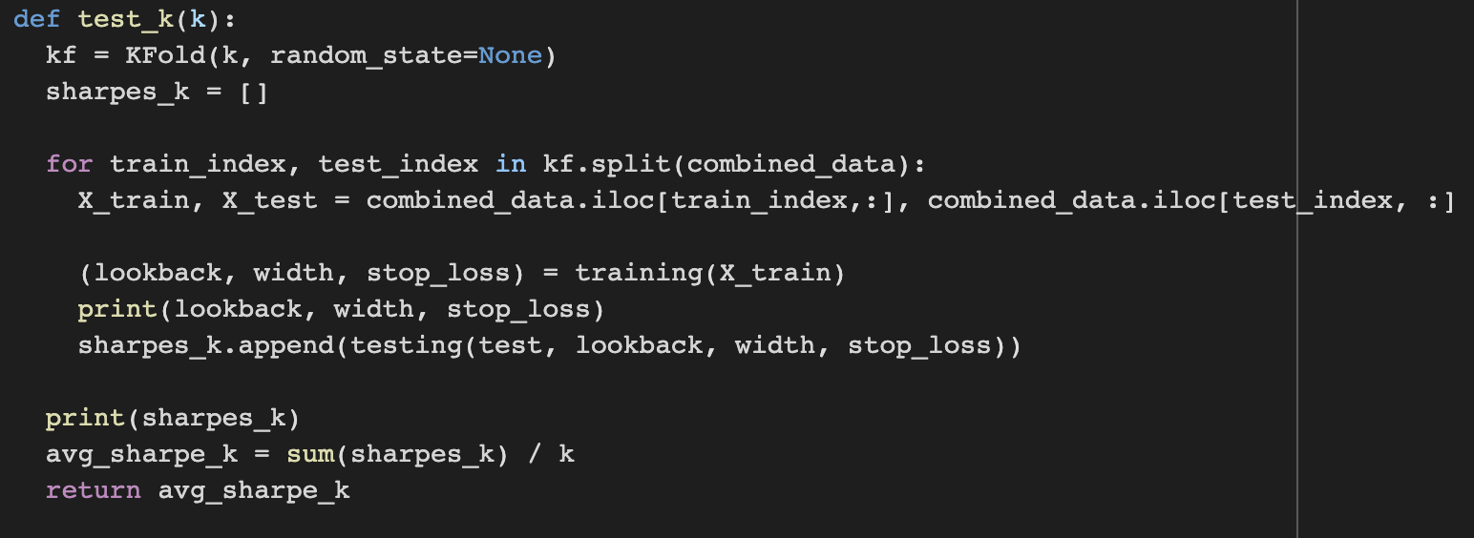
Data Split
Used K-Fold Cross-Validation to check for overfitting
80% train, 20% test
K=5
Avg sharpe = 0.594

Slide 18
Concerns/Improvements
Overly-cautious
Strategy makes very few trades
Can parameterize position size and threshold for taking profit
Correlation between underlying assets can be improved

Slide 19
ROADMAP FOR FUTURE IMPROVEMENTS
Reduce run-time when finding parameters
Implement parameterization of threshold for taking profits and position size
Find more closely correlated energy products
1
2
3

Slide 20

THANKS!
Questions? Comments?

Slide 21
Idea
Very volatile commodities
Intersection with politics and macroeconomic news
Integral to economy and quality of life
Notes:
“Prices of basic energy (natural gas, electricity, heating oil) are generally more volatile than prices of other commodities. One reason that energy prices are so volatile is that many consumers are extremely limited in their ability to substitute other fuels when the price, of natural gas for example, fluctuates. Residential customers usually cannot replace their heating system quickly--and in the long run, it may not be economical to do so. So, while consumers can substitute readily between food products when relative prices of foodstuffs change, most do not have that option in heating their homes.”

